Slide 1
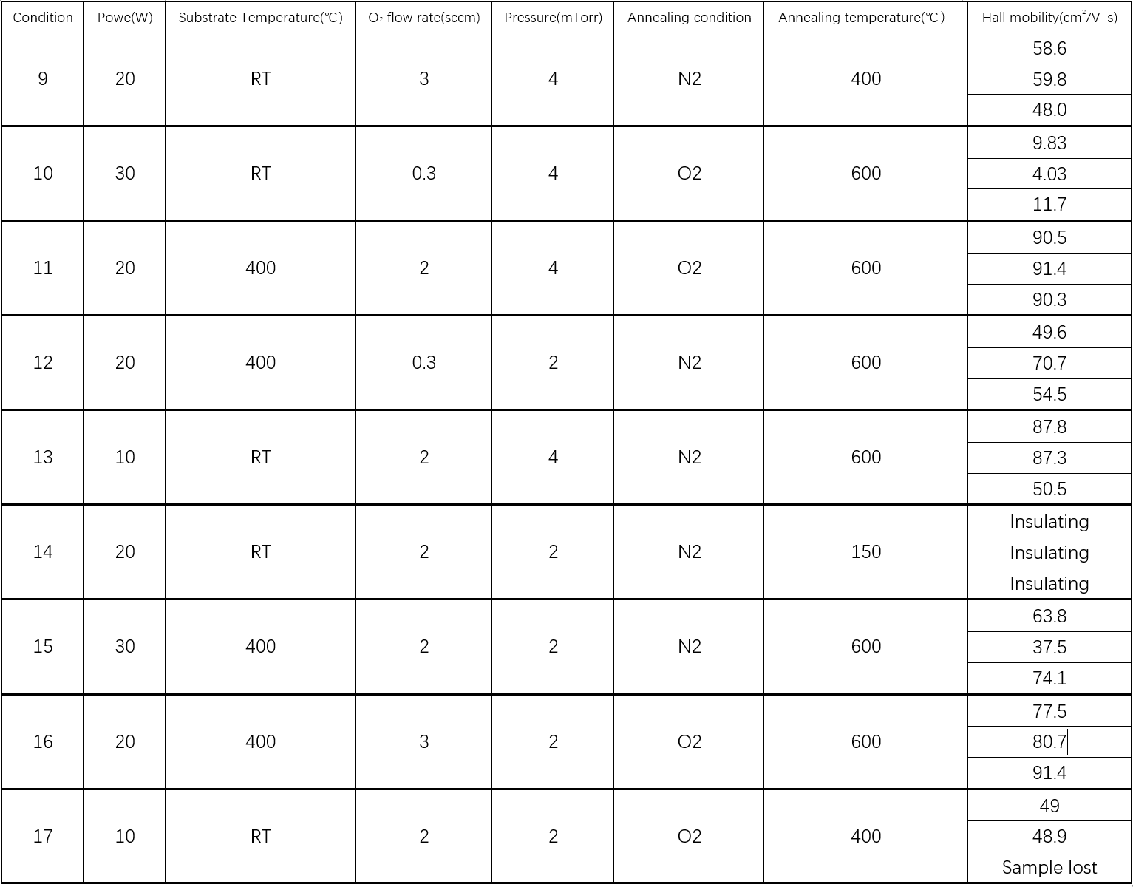

Slide 2
XRD data
 | Condition 9 |  |  | Condition10 |  |  | Condition11 |  |  | Condition12
Sample | 1 | 2 | 3 | 1 | 2 | 3 | 1 | 2 | 3 | 1 | 2 | 3
Peak position | No peak | 31.0; | 30.7 | 30.6 | 31.1 | 30.6 | 30.5 | 30.6 | 30.7 | 30.7 | 30.6 | 30.7
Height | / | 335 | 785 | 6940 | 7178 | 6731 | 11414 | 11466 | 12030 | 8090 | 8776 | 9002
FWHM | / | 0.64 | 0.54 | 0.41 | 0.46 | 0.46 | 0.72 | 0.70 | 0.71 | 0.49 | 0.48 | 0.48

Slide 3
XRD data
 | Condition 13 |  |  | Condition14 |  |  | Condition15 |  |  | Condition16
Sample | 1 | 2 | 3 | 1 | 2 | 3 | 1 | 2 | 3 | 1 | 2 | 3
Peak position | 30.6 | 30.5 | 30.7 | 30.0 | 29.8 | 29.9 | 30.6 | 30.6 | 30.6 | 30.6 | 30.6 | 30.6
Height | 4397 | 5551 | 5837 | 3384 | 3492 | 3079 | 16317 | 31187 | 17563 | 16950 | 20250 | 19761
FWHM | 0.66 | 0.71 | 0.72 | 0.97 | 1.02 | 1.03 | 0.56 | 0.45 | 0.54 | 0.62 | 0.64 | 0.61
 | Condition 17
Sample | 1 | 2 | 3
Peak position | 30.5 | 30.5 | Sample lost
Height | 9462 | 9657 | Sample lost
FWHM | 0.67 | 0.65 | Sample lost

Slide 4
XPS data
Sample | 9-1 | 9-2 | 9-3 | 10-1 | 10-2 | 10-3 | 11-1 | 11-2 | 11-3 | 12-1 | 12-2 | 12-3 | 13-1 | 13-2 | 13-3
In3d | 451.5, 443.9 | 451.9, 444.4 | 451.7, 444.2 | 451.4, 443.8 | 451.4, 444.0 | 451.4, 443.9 | 451.7, 444.2 | 451.7, 444.2 | 451.6, 444.1 | 451.6, 444.0 | 451.8, 444.3 | 451.7, 444.1 | 451.4, 443.9 | 451.3, 443.7 | 451.4， 443.8
O1s | 529.4 | 529.9 | 529.9 | 529.4 | 529.4 | 529.4 | 529.8 | 529.6 | 529.6 | 529.5 | 529.8 | 529.7 | 529.4 | 529.5 | 529.3
Ta4f | Too weak | Too weak | Too weak | 27.1 25.3 | 27.3 25.4 | 27.3 25.4 | Too weak | Too weak | Too weak | 27.8 25.8 | 27.7 25.8 | 27.6 25.8 | Too weak | Too weak | Too weak
Area In3d | 27721 | 28773 | 26069 | 26914 | 27197 | 25793 | 29816 | 31302 | 30849 | 27204 | 26546 | 27019 | 28912 | 30230 | 29592
Area O1s | 4394 | 3799 | 4169 | 3753 | 3919 | 3938 | 3832 | 4026 | 3999 | 3364 | 4204 | 4183 | 3866 | 4129 | 4254
Area Ta4f | Too low | Too low | Too low | 681 | 635 | 699 | Too low | Too low | Too low | 251 | 245 | 270 | Too low | Too low | Too low

Slide 5
XPS data
Sample | 14-1 | 14-2 | 14-3 | 15-1 | 15-2 | 15-3 | 16-1 | 16-2 | 16-3 | 17-1 | 17-2 | 17-3
In3d | 451.4, 443.8 | 451.4, 443.9 | 451.4, 444.0 | 451.7, 444.2 | 451.8, 444.1 | 451.6, 444.0 | 451.7, 444.1 | 451.6, 444.0 | 451.8, 443.9 | 451.7, 443.9 | 451.4, 443.8 | 451.5, 444.0
O1s | 529.3 | 529.3 | 529.3 | 529.6 | 529.7 | 529.7 | 529.6 | 529.5 | 529.5 | 529.7 | 529.2 | 529.4
Ta4f | Too weak | Too weak | Too weak | 27.8 25.9 | 27.7 26.0 | 27.9 26.2 | Too weak | Too weak | Too weak | Too weak | Too weak | Too weak
Area In3d | 26809 | 25545 | 26054 | 26702 | 25528 | 26149 | 28004 | 29267 | 30903 | 29173 | 28449 | 27670
Area O1s | 3597 | 3633 | 3946 | 3586 | 3964 | 3736 | 4074 | 3852 | 3767 | 3828 | 3341 | 3789
Area Ta4f | Too low | Too low | Too low | 171 | 248 | 204 | Too low | Too low | Too low | Too low | Too low | Too low

Slide 6
Comments
We noticed that the O₂ flow rate during sputtering (0.3–3 sccm) appears to strongly affect the deposition rate, especially for Ta₂O₅. XPS shows that the Ta peak area decreases as the O2 flow increases. However, since other parameters were changing as well, it is difficult for us to isolate the effect. Would it be possible to check this trend in your model? If that is not straightforward, we can also run some controlled experiments on our side.
Additionally, we currently set the minimum O₂ flow to 0.3 sccm. However, the system also allows O₂ = 0 sccm (i.e., O₂ completely off). If O₂ is enabled, the minimum setpoint is 0.3 sccm. Do you think we should also include the 0 sccm condition in our design?

